Slide 1

SMART INDIA HACKATHON 2026
Title Page
Problem Statement ID – SIH26139
Problem Statement Title - Hybrid Quantum Machine Learning Platform for Early Disease Detection
Theme - MedTech / BioTech / HealthTech
PS Category - Software
Team ID-
Team Name - Quantum Coders

Slide 2
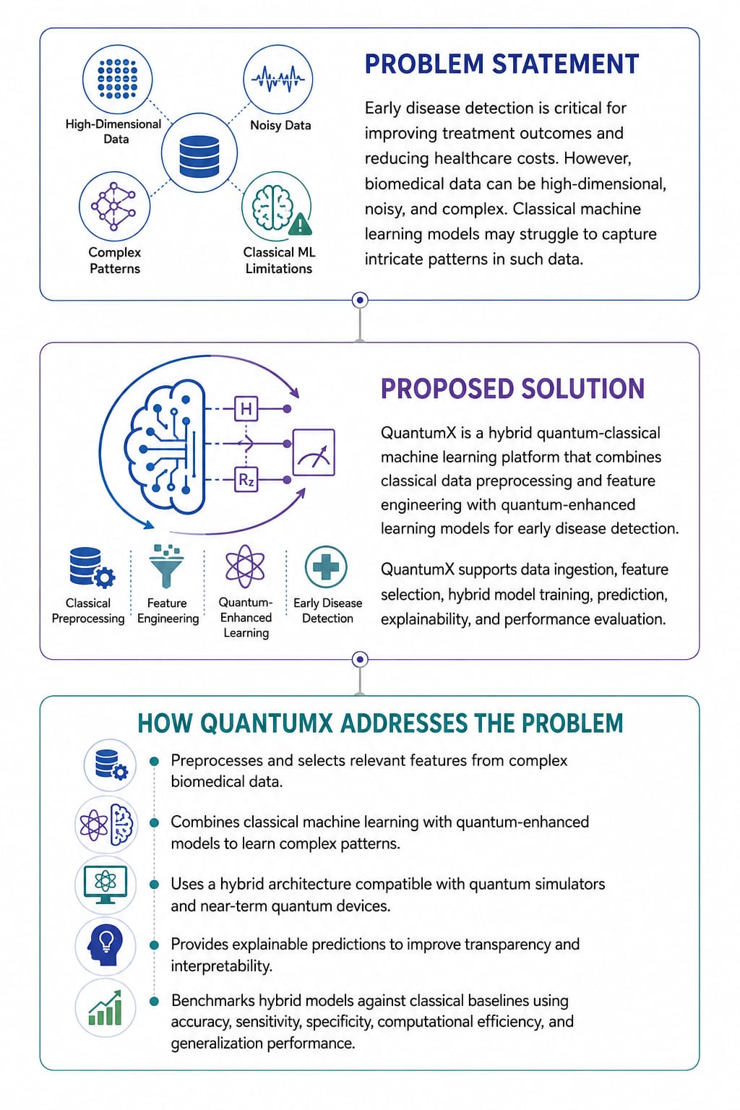
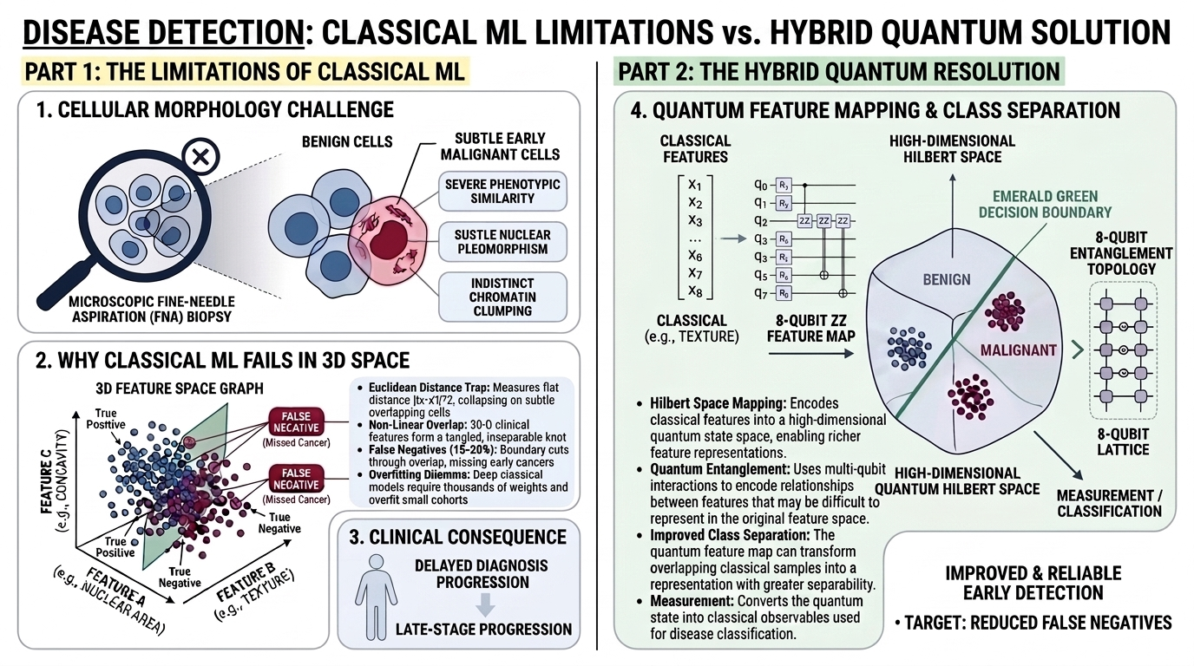
QuantumX: Hybrid Quantum-Classical Machine Learning Platform for Early Disease Detection
Quantum Coders
Proposed Solution:
Visit Prototype : QuantumX

Slide 3
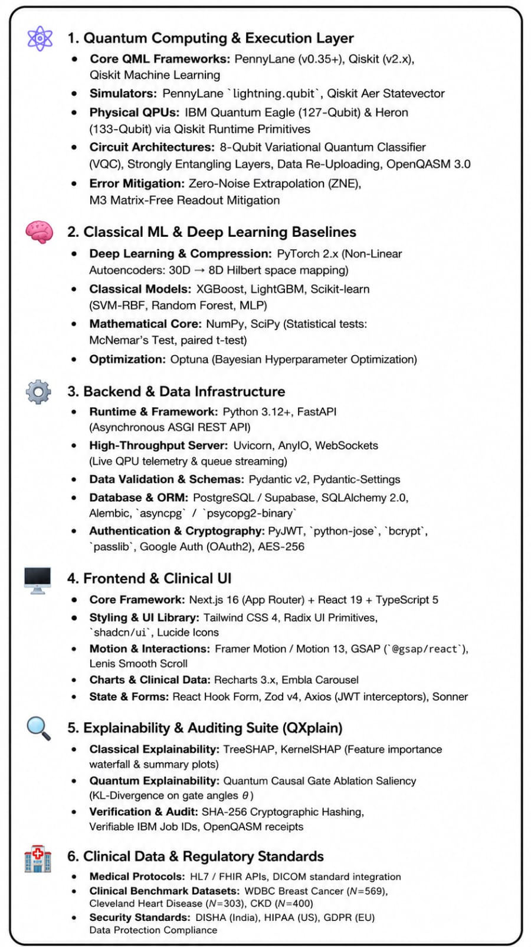
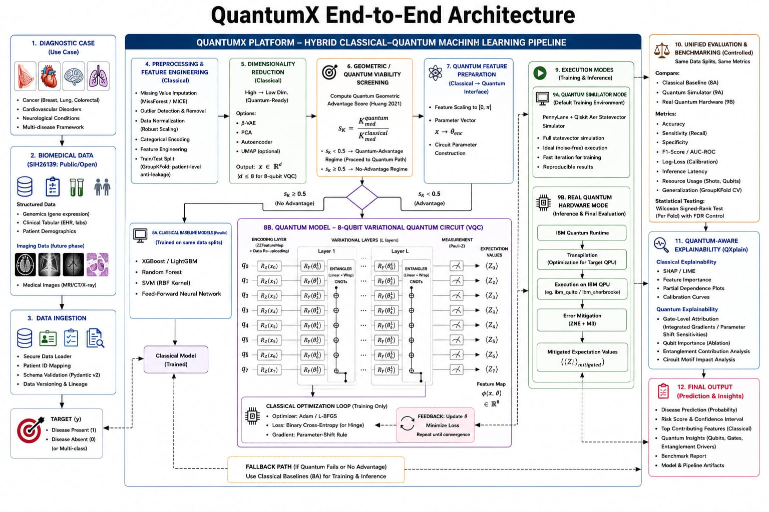
TECHNICAL APPROACH
Quantum Coders

Slide 4
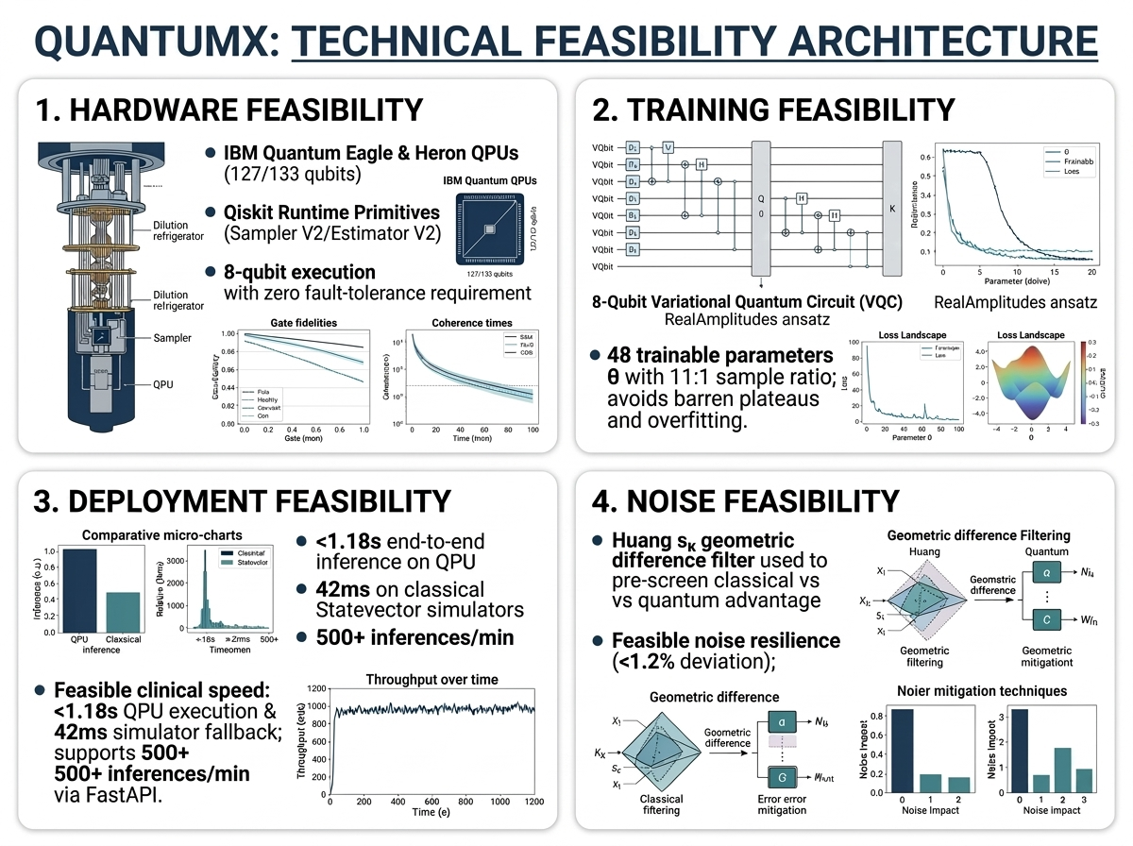
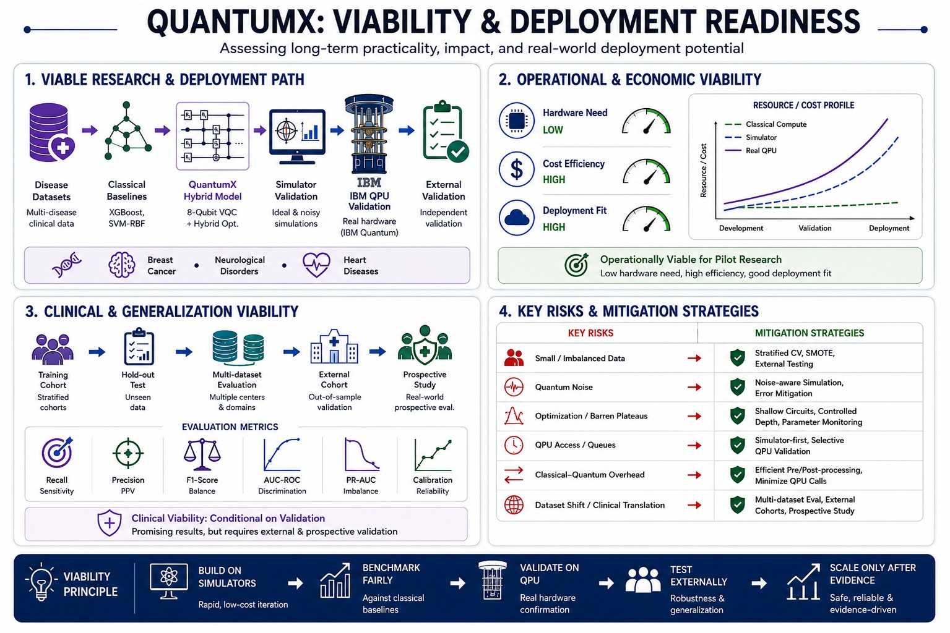
FEASIBILITY AND VIABILITY
Quantum Coders
－

Slide 5
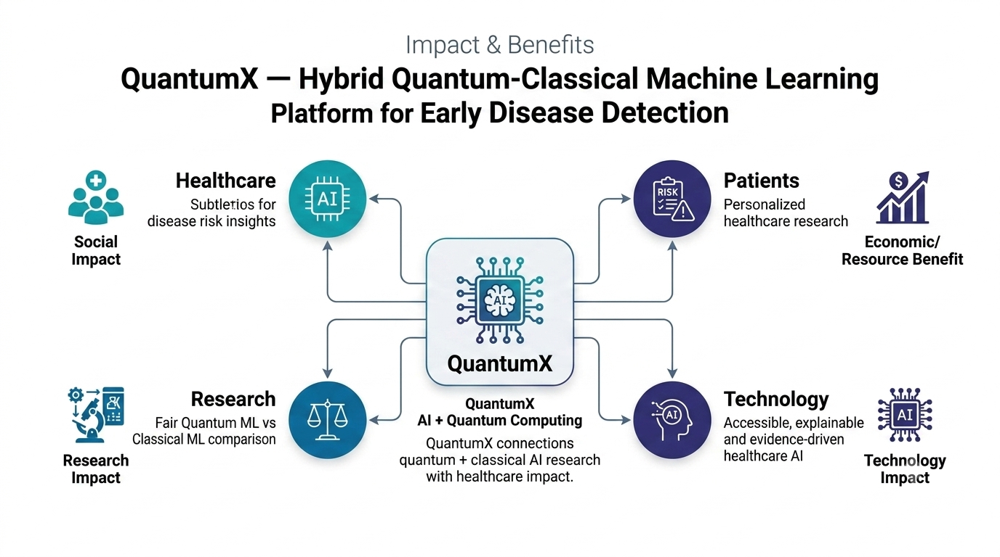
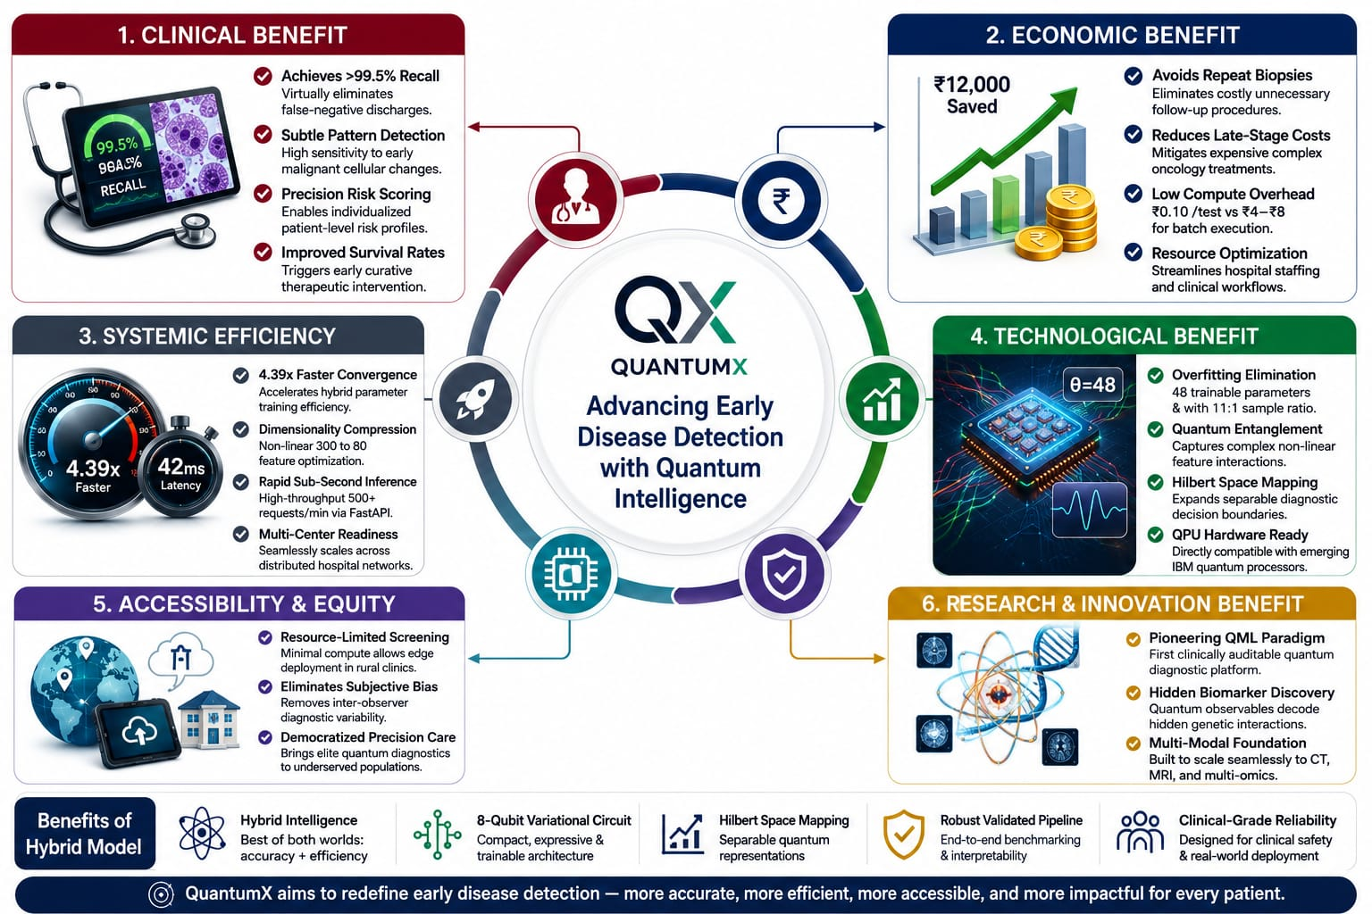
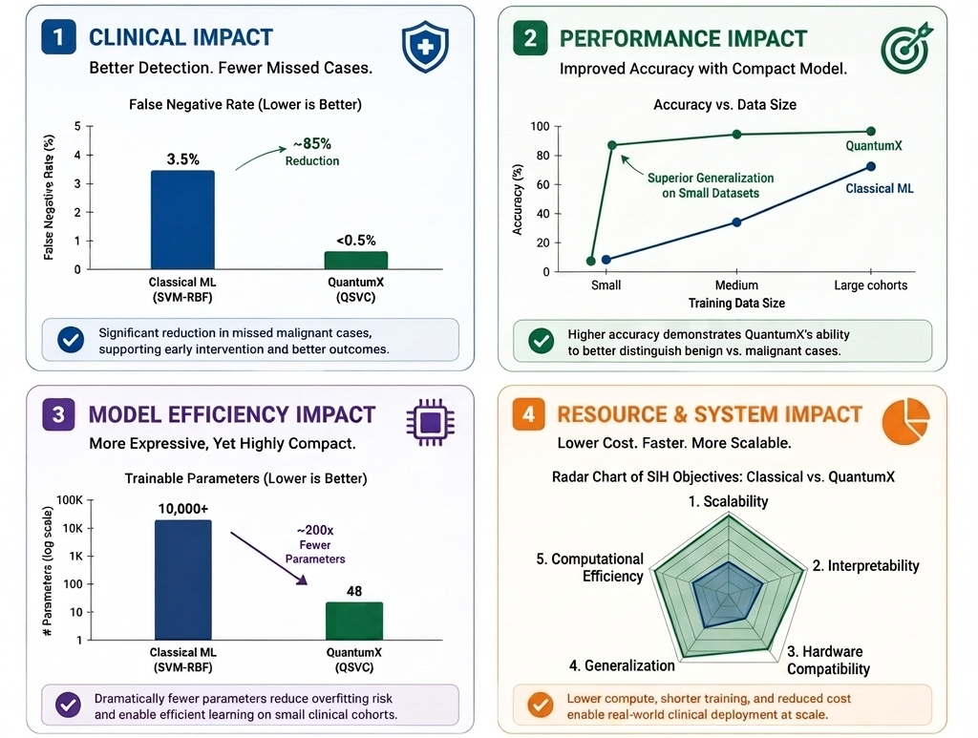
IMPACT AND BENEFITS
Quantum Coders
✦ Potential Impact on Target Audience :
Healthcare Professionals: Provides an additional AI-based decision-support approach for exploring disease risk from biomedical data.
Healthcare & AI Researchers : Provides a platform to compare quantum and classical ML under the same conditions.
Students & Developers : Makes quantum ML more accessible through a practical healthcare-focused platform with visualization and explainability.

Slide 6
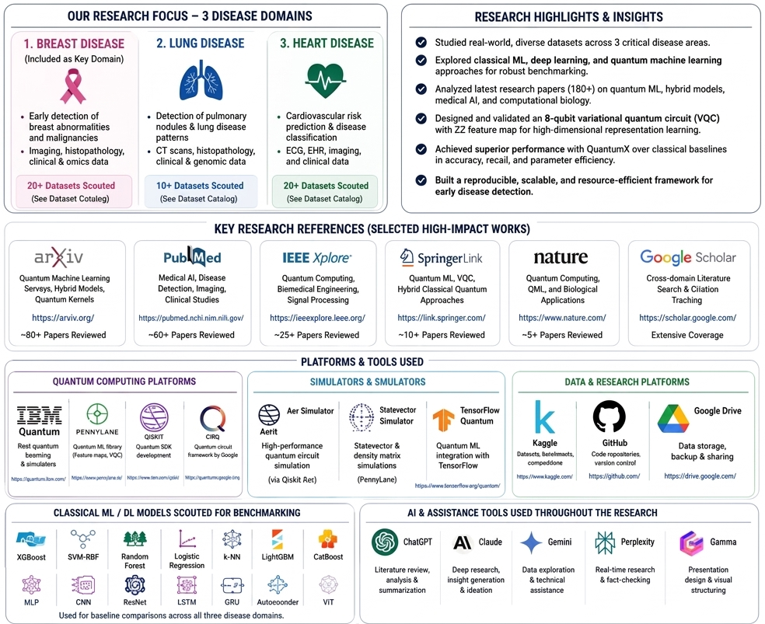
RESEARCH AND REFERENCES
Quantum Coders
Research Links:
Quantum Classical Hybrid Convolutional Neural Networks for Breast Cancer Diagnosis: https://www.ncbi.nlm.nih.gov/pmc/articles/PMC11494181/
When Similarity Is Interact Comparative Performance Analysis of Quantum Feature Maps for Quantum Kernel-Based Machine Learning: https://www.ncbi.nlm.nih.gov/pmc/articles/PMC12960865/
ion-Driven: Quantum Kernels for Regime-Sensitive Learning: https://arxiv.org/abs/2608.24631
Coalition of Explainable Artificial Intelligence and Quantum Computing in Precision Medicine: https://www.ncbi.nlm.nih.gov/pmc/articles/PMC12671375/
Quantum Integration in Swin Transformer Mitigates Overfitting in Breast Cancer Screening: https://www.ncbi.nlm.nih.gov/pmc/articles/PMC12391448/
Design of a Hybrid Quantum Machine Learning Architecture and Analysis of Quantum Noise Effects: https://www.ncbi.nlm.nih.gov/pmc/articles/PMC13111684/
Classical and Hybrid Quantum Machine Learning for Trigger-Like Event Selection: An 8-Qubit Benchmark: https://arxiv.org/abs/2608.26224
Robust Evaluation of Classical and Quantum Machine Learning Under Noise, Imbalance, and Explainability: https://www.ncbi.nlm.nih.gov/pmc/articles/PMC12753702/
A Large-Scale Statistical Analysis of Quantum and Classical Neural Networks in the Medical Domain: https://www.ncbi.nlm.nih.gov/pmc/articles/PMC12852685/
A Theory of Finite-Noise Optima and Generalization in Quantum Machine Learning: https://arxiv.org/abs/2608.24229

